Slide 1
The Politics of Play: Wargaming with the US Military
Dr Aggie Hirst
Senior Lecturer in IR Theory and Methods
Department of War Studies
King’s College London
Aggie.Hirst@kcl.ac.uk

Slide 2
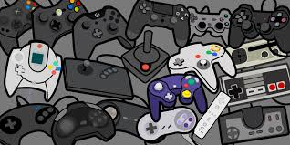
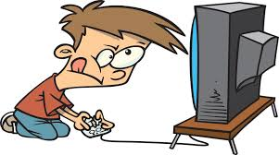
The gaming revolution
The ‘ludic century’
The ‘digital native’
Gamification
Recreation/leisure
Child and adult education
Training
Commercial/advertising
Military applications

Slide 3
The politics of play: wargaming with the US military
Main research project since 2017
Funded by grants from Leverhulme Trust and British Academy
100+ hours of interview with US military gaming community
Core aims:
Moving from recreational to military gaming in IR
Introducing the study of play to IR
Articles published: Play in(g) International Theory, States of Play, Videogames Saved My Life
Book project - The Politics of Play: Wargaming with the US Military: OUP, 2022

Slide 4
Project Overview
Key questions:
How does military pedagogical wargaming work?
What impacts does immersive training have on trainees?
What are the politics of harnessing play for military purposes?
Play as pedagogy
Immersion – tension with player agency
What matters is less what we play and more how we play
So, retheorisation of play: From Apollonian/Dionysian play to Deconstructive play

Slide 5
What is a wargame?
Lack of consensus among community of practice (CoP)
Game vs sim
Manual vs digital
Commercial vs military
Deterministic vs open-ended
Product or process; skills or experience?
Purpose
Research, teaching, training
All wargames are ‘edutainment’?

Slide 6
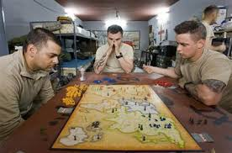
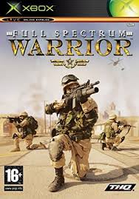
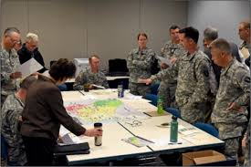
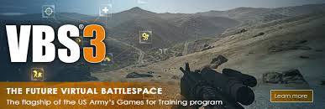
US military wargames

Slide 7
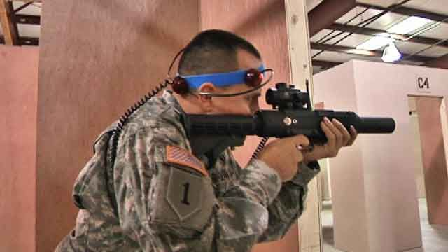
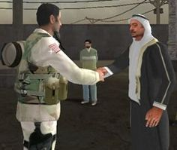
Us military wargaming
Since 2014 a ‘renaissance’ in US military wargaming – Work, Hagel memos
Key areas:
Weapons, vehicle, tactical,
operations training
Strategic and doctrine
Language and ‘cultural sensitivity’
Rehabilitation and therapy

Slide 8
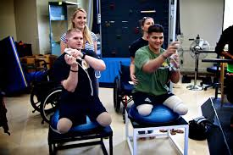
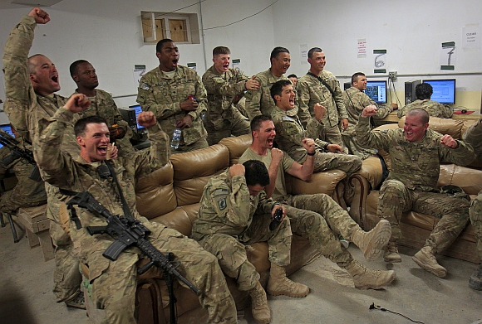
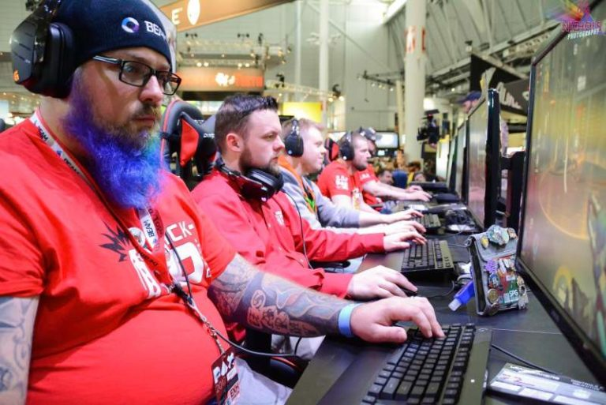
Pre, during, and post deployment
Teaches and trains service members
Deployment downtime
Rehabilitation following injury (respawn)
‘Gaming saved my life’

Slide 9
Why use wargaming in the military?
Cost effective
Replicable and ‘safe to fail’
Draws on skills and interests of digital native generation
Increases attention and retention
Introduces fun/enjoyment into training environment
Multi side-benefits – diplomacy, unit cohesion, transferable skills
It ‘enable[s] individual participants to transform themselves by making them more open to internalizing their experiences in a game’ (Perla and McGrady, 2011)
‘Offloads some of the cognitive burden’ (Gee)
‘Performance before competence’ (Gee)

Slide 10
Why use Wargaming in the military?
Bloom’s ‘Taxonomy of Learning Domains’
‘Wargaming is a cost-effective means to provide experience-based learning with emphasis on cognitive and, increasingly, affective training domains.’ (Roman and Brown)

Slide 11
Why use wargaming?
Military view
Learning objectives coded into game to form victory conditions (winning, not losing, losing under x conditions)
Realisation of learning objectives is criterion of success
Seek deeper and long-lasting immersive play by suspending trainees in flow state
But, what does this ignore?
The politics of using play for military ends
How does wargaming teach trainees/players and with what effects?
Tension between immersion and agency

Slide 12
wargaming as Pedagogy
Key distinction
Play: an exploratory human capacity or ability
Game: a system or structure which apprehends and directs play
In the case of using games as teaching tools, we are harnessing play for particular pedagogical ends
Game always designed/selected for specific purpose/aim/objective
True whether teaching in civilian or military context
Key claim: All wargames teach their players, whether intended for education or not
Challenge conventional distinction between education and analytic/research gaming

Slide 13
Understanding play
To understanding gaming, need to understand play
Often considered frivolous or juvenile
Children, animals, time off
But scholars emphasise it is vital for life
Essential category of existence, how we grow, learn, socialise
‘What makes life lifey’ – without play, just survival
Complicated
Both truth and illusion, real and non real, phenomenon and subjectivity

Slide 14
Apollonian play: The Primacy of Reason over play
Plato, Aristotle, German Idealism
The ‘malediction of play’ in modern Western philosophy (Nagel)
Play frivolous and in opposition to reason – a hinderance to learning
‘The explicit goal of the first Critique [of Pure Reason] is to replace the ‘mere play’ of the imagination and thought… with the seriousness of scientific investigation’ (Spariosu, Dionysus Reborn, 1989).

Slide 15
Dionysian PLay: The Primacy of Play over Reason
Pre-Socratic, post-Idealist – Heraclitus, Nietzsche
Subordinates reason to aesthetics
Play is a dance between creativity and nihilism
‘The maturity of man [sic] - that means, to have reacquired the seriousness that one had as a child at play’ (Beyond Good and Evil).

Slide 16
The seriousness of play
Understood as behaviour, action, motivation, attitude, experience, existential condition
A powerful form of communication and metacommunication
Tells us about what it communicates
Bateson’s wolf cubs – ‘this nip is not a bite’
Highly absorbing – ‘autotelic’
Decreased sense of self, self-forgetfulness
Exists in own spatial and temporal zone - in and outside reality
Self-renewing desire to continue
For its own sake, an end in itself – though can be harnessed for extrinsic ends (Csikszentmihalyi)

Slide 17
How does wargaming teach using play?
1) For the Win
Players must play to win
Fairly easy to realise as winning is fun
Noone likes to lose
Winning key to military socialisation
Often framed at natural or spontaneous by the CoP, but actually has to be continuously cultivated
A win state usually irrelevant. What’s important is pursuit of conditions
Necessary for validity

Slide 18
How does wargaming teach using play?
2) The spell of immersion
Pleasure of game generated by experience of immersion
Inner critic switched off, ‘chronoslip’ occurs
Feedback loop of cause and effect
Symbiosis of action and reaction
But, spell can be broken
If conscious thought occurs, condition is lost
Back to reality, often with a bump
Also necessary for game validity according to many in CoP

Slide 19
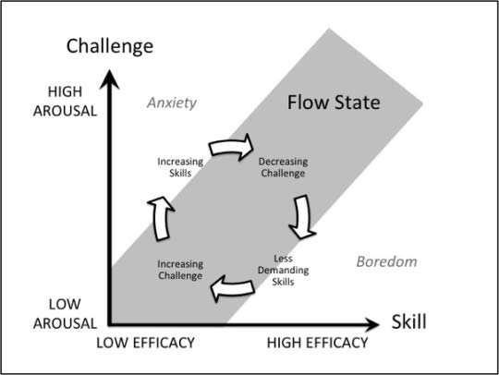
How does wargaming work?
‘Flow is an optimal state of consciousness, a peak state where we both feel and perform our best. We become so involved in an activity that nothing else seems to matter. The ego falls away. Time flies. Every action, movement and thought follows inevitably from the previous one, like playing jazz. Your whole being is involved, and you’re using your skills to the utmost.’ (Csikszentmihalyi)

Slide 20
Gadamer: The Power of Play
‘All playing is a being-played... The attraction of a game, the fascination it exerts, consists precisely in the fact that the game masters the players… The real subject of the game… is not the player but instead the game itself. What holds the player in its spell, draws him into play, and keeps him there is the game itself’ (Truth and Method)

Slide 21
Freire: Immersion as a non-reflexive state
‘Animals do not consider the world; they are immersed in it’ (Pedagogy of the Oppressed).
Immersion circumvents reflexivity
The player becomes the object of the game, rather than its subject
Echoes of Gadamer… the game plays the player

Slide 22
Breaking the spell
If conscious thought breaks spell, this means that immersion in a non-reflexive state
Can only be immersive is experiencing unity of thought and action
This means that the conscious thinking capacities of the immersed player are suspended
Immersion circumvents reflexivity
The player becomes the object of the game, rather than its subject
Far from the player playing the game, the game plays the player

Slide 23
So, what is to be done?
While this might be efficacious from a military training perspective, clearly highly problematic from point of view of player agency and pedagogical theory
How do we avoid becoming the passive objects of gameplay?
Prioritise play over game
Play a force, mode, or capacity
Game a structure that contains and arrests play
Play game playfully. Game the game. Do fight the scenario
What matters is not what we play but rather how we play

Slide 24
Deconstructive play
Critical thinking and engagement
Punctuate immersion with critical reflection
Play deconstructively – keep the play in play
The game is a text to be read
What are its rules?
What story is being told, and from whose perspective?
Who are its heroes and villains?
What acts am I being rewarded/punished for?
What are gendered/ racialised/colonial tropes at work?
Modding/hacking/counterludic identities

Slide 25
reTheorising play
Type of Play | Era | Figures | Subject | Features
Dionysian | Presocratic, Post-Nietzschean | Heraclitus, Nietzsche | Aristocratic hero-warrior, child | Disorder, frenzy, aesthetics, affect, spontaneity
Apollonian | Socratic to Modern | Plato, Aristotle, Kant, Huizinga, Schiller, Gadamer | Rational man, philosopher | Order, reason, law, moderation, sobriety, morality
Deconstructive | Postmodern | Derrida | Auto-deconstructive | Perpetual motion, exposing power relations

